Slide 1
Presentation Time must be 15 minutes.
5 Minutes for Questions!!

Slide 2
Outline
Introduction - Background - Experimental Results - Conclusion and Future Work
Introduction
Background
Experimental Results
Conclusion and Future Work
Notes:
There are 4 parts for our presentation. I will be responsible for the introduction, Background and 1 of the experiment results of our research project. And Fraybe and Zuoyi will take the rest of the experiments and conclusion parts.

Slide 3
Are Vision Transformer Models more Adversarially Robust than Convolutional Neural Networks?
Chenkai Su, K. Faryab Haye, Zuoyi Li
Notes:
Hi, My name is Chenkai. My teammates are Faryab and Zuoyi. Our research topic is: Are Vision Transformer Models more Adversarially Robust than Convolutional Neural Networks?

Slide 4
Introduction
Notes:
First, Introduction!

Slide 5
Introduction
--Motivation
Introduction - Background - Experimental Results - Conclusion and Future Work
An Image is Worth 16x16 Words: Transformers for Image Recognition at Scale(ViT)
ViT: High accuracy and efficiency
Is ViT more robust to adversarial attack ?
Notes:
The paper, An Image is Worth 16x16 Words:. from Google Research, proposes an architecture called Vision Transformer (briefly we called it ViT) to process image data using transformers.
The ViT model reach slightly higher accuracy at significantly reduced training time compared with the other state-of-art image recognition model.
However, there is no work related to the robustness of the ViT Model in recent paper since the model is proposed in last year.
As a student in our course, it is natural for us to come up with a question: is ViT more robust to the adversarial attack?

Slide 6
Background
Notes:
Then, Let me briefly introduce some background of the Vision transformer model.

Slide 7
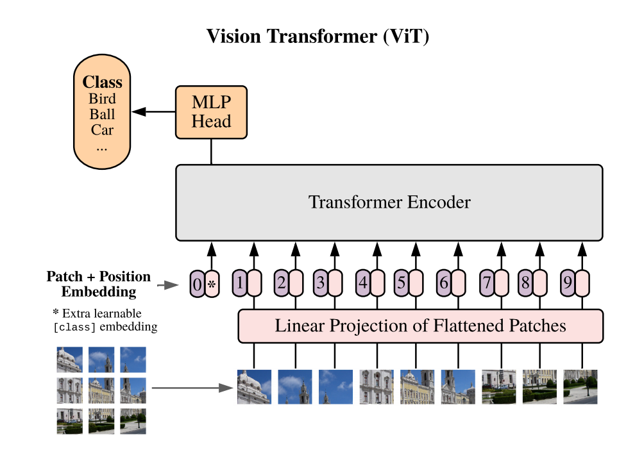
Background
--Vision Transformer(ViT)
Introduction - Background - Experimental Results - Conclusion and Future Work
Notes:
Here is the main framework for ViT model.
Basically, the whole image has been divided into small patches and then put into the transformer encoder to do classification task.

Slide 8
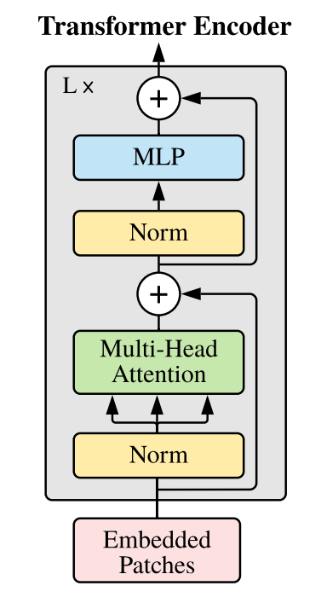
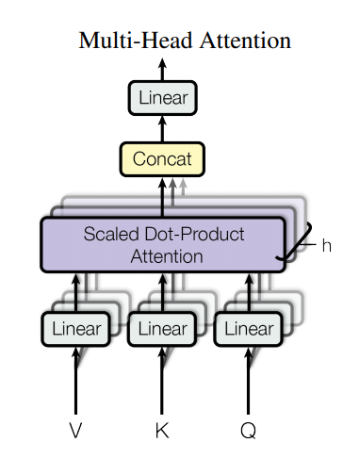
Background
--Vision Transformer(ViT)
Introduction - Background - Experimental Results - Conclusion and Future Work
Multi- Head Attention Layers:
Parallel computing
Capture information for long sequence
Positional Encoding:
Learn the information of sequence order
Notes:
Here is a more detailed structure of the transformer encoder.
There are two layers that is very important to us.
The first one is Multi-head attention layer, which contributes to the parallel computing and spatial information extraction of long sequence.
The second layer is positional encoding layer which learns the information of sequence order.

Slide 9
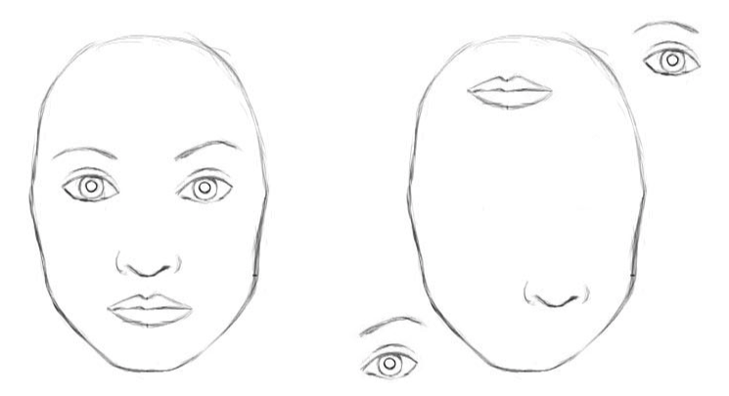
Background
--ViT vs CNN?
Introduction - Background - Experimental Results - Conclusion and Future Work
ViT could detect location information better than CNN
Notes:
So one question we might ask is what is the difference between ViT and CNN.
Let’s see this sketch. CNN will consider them to be similar to each other. It needs more deeper layer to distinguish this similarity. However, the ViT could detect such location information better than the CNN.

Slide 10
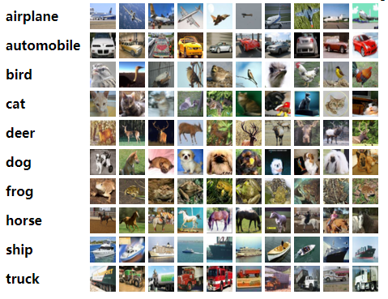
Background
--Datasets & Models
Introduction - Background - Experimental Results - Conclusion and Future Work
CIFAR-10
60000 images in 32x32 size
10 classes
Notes:
We performed our experiments on the CIFAR-10 Dataset

Slide 11
Experimental Results
Notes:
Next part is our Experiment Results.

Slide 12
Experiment Results
--4 Main Experiment results
Introduction - Background - Experimental Results - Conclusion and Future Work
Whitebox Attacks
Adversarial Training
Transfer Attack
Visualization
Notes:
Here are the 4 main parts of our experiment results.
We first attack the ViT model by whitebox attacks.
Then we conduct adversarial training to ViT model.
In order to explore the relationship between CNN model and ViT model, we also conduct transfer attack to both models.
At last, we try to analyze our results by visualization.

Slide 13
Experiment Results
--4 Main Experiment results
Introduction - Background - Experimental Results - Conclusion and Future Work
Whitebox Attacks
Adversarial Training
Transfer Attack
Visualization
Notes:
First, Whitebox attacks.

Slide 14
Experiment Results
-- Whitebox attacks
Introduction - Background - Experimental Results - Conclusion and Future Work
Attack \ Model | epsilon | alpha | ViT (224*224) | ViT (32*32) | VGG16 (32*32)
None | None | None | 98.52 % | 98.74% | 92.52 %
PGD-1 | 8/255 | 2/255 | 44.84 % | 48.26% | 40.19 %
PGD-5 |  |  | 1.78 % | 2.07% | 6.93 %
PGD-10 |  |  | 0.98 % | 0.86% | 4.7 %
PGD-20 |  |  | 0.96 % | 0.77% | 4.46 %
PGD-20 L2 | 8/255 | 2/255 | 98.45 % | 96.69 % | 32.65 %
PGD-20 L2 | 25/255 | 5/255 | 95.94 % | 78.15 % | 29.51 %
PGD-20 L2 | 50/255 | 12/255 | 86.71 % | 37.88 % | 23.34 %
PGD-20 L2 | 100/255 | 20/255 | 53.37 % | 9.32 % | 18.16 %
Notes:
We first conduct pgd attack to both VGG16 CNN model and ViT model.

Slide 15
Experiment Results
-- Whitebox attacks
Introduction - Background - Experimental Results - Conclusion and Future Work
Attack \ Model | epsilon | alpha | ViT (224*224) | ViT (32*32) | VGG16 (32*32)
None | None | None | 98.52 % | 98.74% | 92.52 %
PGD-1 | 8/255 | 2/255 | 44.84 % | 48.26% | 40.19 %
PGD-5 |  |  | 1.78 % | 2.07% | 6.93 %
PGD-10 |  |  | 0.98 % | 0.86% | 4.7 %
PGD-20 |  |  | 0.96 % | 0.77% | 4.46 %
PGD-20 L2 | 8/255 | 2/255 | 98.45 % | 96.69 % | 32.65 %
PGD-20 L2 | 25/255 | 5/255 | 95.94 % | 78.15 % | 29.51 %
PGD-20 L2 | 50/255 | 12/255 | 86.71 % | 37.88 % | 23.34 %
PGD-20 L2 | 100/255 | 20/255 | 53.37 % | 9.32 % | 18.16 %
Notes:
You might notice that there are two ViT models and one VGG16 model here.
The original input image for our fine-tune ViT model is from imageNet.
So the input of the first ViT model is the same size as the original input, which is 224 multiply by 224.
The input of the second ViT model is 32 multiply by 32, which is the size of Cifer-10 dataset.

Slide 16
Experiment Results
-- Whitebox attacks
Introduction - Background - Experimental Results - Conclusion and Future Work
Attack \ Model | epsilon | alpha | ViT (224*224) | ViT (32*32) | VGG16 (32*32)
None | None | None | 98.52 % | 98.74% | 92.52 %
PGD-1 | 8/255 | 2/255 | 44.84 % | 48.26% | 40.19 %
PGD-5 |  |  | 1.78 % | 2.07% | 6.93 %
PGD-10 |  |  | 0.98 % | 0.86% | 4.7 %
PGD-20 |  |  | 0.96 % | 0.77% | 4.46 %
PGD-20 L2 | 8/255 | 2/255 | 98.45 % | 96.69 % | 32.65 %
PGD-20 L2 | 25/255 | 5/255 | 95.94 % | 78.15 % | 29.51 %
PGD-20 L2 | 50/255 | 12/255 | 86.71 % | 37.88 % | 23.34 %
PGD-20 L2 | 100/255 | 20/255 | 53.37 % | 9.32 % | 18.16 %
Notes:
Alpha here will be the step-size of the pgd attack.

Slide 17
Experiment Results
-- Whitebox attacks
Introduction - Background - Experimental Results - Conclusion and Future Work
Attack \ Model | epsilon | alpha | ViT (224*224) | ViT (32*32) | VGG16 (32*32)
None | None | None | 98.52 % | 98.74% | 92.52 %
PGD-1 | 8/255 | 2/255 | 44.84 % | 48.26% | 40.19 %
PGD-5 |  |  | 1.78 % | 2.07% | 6.93 %
PGD-10 |  |  | 0.98 % | 0.86% | 4.7 %
PGD-20 |  |  | 0.96 % | 0.77% | 4.46 %
PGD-20 L2 | 8/255 | 2/255 | 98.45 % | 96.69 % | 32.65 %
PGD-20 L2 | 25/255 | 5/255 | 95.94 % | 78.15 % | 29.51 %
PGD-20 L2 | 50/255 | 12/255 | 86.71 % | 37.88 % | 23.34 %
PGD-20 L2 | 100/255 | 20/255 | 53.37 % | 9.32 % | 18.16 %
Notes:
We could see from the table that both of the two models gain very high accuracy on the Cifer-10 dataset.

Slide 18
Experiment Results
-- Whitebox attacks
Introduction - Background - Experimental Results - Conclusion and Future Work
Attack \ Model | epsilon | alpha | ViT (224*224) | ViT (32*32) | VGG16 (32*32)
None | None | None | 98.52 % | 98.74% | 92.52 %
PGD-1 | 8/255 | 2/255 | 44.84 % | 48.26% | 40.19 %
PGD-5 |  |  | 1.78 % | 2.07% | 6.93 %
PGD-10 |  |  | 0.98 % | 0.86% | 4.7 %
PGD-20 |  |  | 0.96 % | 0.77% | 4.46 %
PGD-20 L2 | 8/255 | 2/255 | 98.45 % | 96.69 % | 32.65 %
PGD-20 L2 | 25/255 | 5/255 | 95.94 % | 78.15 % | 29.51 %
PGD-20 L2 | 50/255 | 12/255 | 86.71 % | 37.88 % | 23.34 %
PGD-20 L2 | 100/255 | 20/255 | 53.37 % | 9.32 % | 18.16 %
Notes:
From the table, we could see that, under the L-infinity norm, the ViT model’s accuracy will be greatly reduced by the attack, which is similar to CNN.

Slide 19
Experiment Results
-- Whitebox attacks
Introduction - Background - Experimental Results - Conclusion and Future Work
Attack \ Model | epsilon | alpha | ViT (224*224) | ViT (32*32) | VGG16 (32*32)
None | None | None | 98.52 % | 98.74% | 92.52 %
PGD-1 | 8/255 | 2/255 | 44.84 % | 48.26% | 40.19 %
PGD-5 |  |  | 1.78 % | 2.07% | 6.93 %
PGD-10 |  |  | 0.98 % | 0.86% | 4.7 %
PGD-20 |  |  | 0.96 % | 0.77% | 4.46 %
PGD-20 L2 | 8/255 | 2/255 | 98.45 % | 96.69 % | 32.65 %
PGD-20 L2 | 25/255 | 5/255 | 95.94 % | 78.15 % | 29.51 %
PGD-20 L2 | 50/255 | 12/255 | 86.71 % | 37.88 % | 23.34 %
PGD-20 L2 | 100/255 | 20/255 | 53.37 % | 9.32 % | 18.16 %
Notes:
However, for the L-2 norm, to our surprised , the ViT model seems to be more robust than the VGG 16, especially under small epsilon value.

Slide 20
Experiment Results
-- Whitebox attacks
Introduction - Background - Experimental Results - Conclusion and Future Work
Attack \ Model | epsilon | alpha | ViT (224*224) | ViT (32*32) | VGG16 (32*32)
None | None | None | 98.52 % | 98.74% | 92.52 %
PGD-1 | 8/255 | 2/255 | 44.84 % | 48.26% | 40.19 %
PGD-5 |  |  | 1.78 % | 2.07% | 6.93 %
PGD-10 |  |  | 0.98 % | 0.86% | 4.7 %
PGD-20 |  |  | 0.96 % | 0.77% | 4.46 %
PGD-20 L2 | 8/255 | 2/255 | 98.45 % | 96.69 % | 32.65 %
PGD-20 L2 | 25/255 | 5/255 | 95.94 % | 78.15 % | 29.51 %
PGD-20 L2 | 50/255 | 12/255 | 86.71 % | 37.88 % | 23.34 %
PGD-20 L2 | 100/255 | 20/255 | 53.37 % | 9.32 % | 18.16 %
Notes:
When we increase the value of the epsilon, the second ViT model performance degrade dramatically.
In the visualization part, Faryab will try to explain the reason for that.
That’s all for my presentation.
Zuoyi will take the next experiment result for you.

Slide 21
Introduction
--Main Contribution
Introduction - Background - Experimental Results - Conclusion and Future Work
Whitebox Attacks
Adversarial Training
Transfer Attack
Visualization

Slide 22
Experiment Results
-- Adversarial Training
Introduction - Background - Experimental Results - Conclusion and Future Work
Adversarial training remains an valid choice to increase ViT model’s robustness;
Haven’t fully explored optimizations for adversarial training.
PGD-5, L-inf, eps = 8/255
Epoch | Adv Ex Gen Time (sec) | Adv Train Time (sec) | Adv Train Acc (%) | Eval Acc On PGD10 (%) | Eval Acc On PGD20 (%) | Eval Acc on Orig (%)
Orig | NA | NA | NA | 0.98 | 0.96 | 98.74
1 | 2458.99 | 663.34 | 93.79 | 91.29 | 91.07 | 93.21

Slide 23
Introduction
--Main Contribution
Introduction - Background - Experimental Results - Conclusion and Future Work
Whitebox Attacks
Adversarial Training
Transfer Attack
Visualization

Slide 24
Experiment Results
-- Transfer Attacks
Introduction - Background - Experimental Results - Conclusion and Future Work
There is low transferability between attacks generated for ViT and for VGG.
Why?
CNNs are translation invariant, have restricted receptive fields;
Transformers can learn local correlations across the whole input image.
Higher attack iterations for ViT-based attacks, lower efficacy.
Attack \ Model | ViT(32*32) (Acc） | Attack \ Model | VGG16(32*32) (Acc）
None | 98.74 % | None | 92.77 %
PGD-1-CNN | 79.74 % | PGD-1-ViT | 56.65 %
PGD-5-CNN | 85.65 % | PGD-5-ViT | 60.74 %
PGD-10-CNN | 83.50 % | PGD-10-ViT | 60.89 %
PGD-20-CNN | 80.97 % | PGD-20-ViT | 63.78 %
L-inf, eps = 8/255

Slide 25
Experiment Results
-- Transfer Attacks
Introduction - Background - Experimental Results - Conclusion and Future Work
There is low transferability between attacks generated for ViT and for VGG.
Why?
CNNs are translation invariant, have restricted receptive fields;
Transformers can learn local correlations across the whole input image.
Higher attack iterations for ViT-based attacks, lower efficacy.
Attack \ Model | ViT(32*32) (Acc） | Attack \ Model | VGG16(32*32) (Acc）
None | 98.74 % | None | 92.77 %
PGD-1-CNN | 79.74 % | PGD-1-ViT | 56.65 %
PGD-5-CNN | 85.65 % | PGD-5-ViT | 60.74 %
PGD-10-CNN | 83.50 % | PGD-10-ViT | 60.89 %
PGD-20-CNN | 80.97 % | PGD-20-ViT | 63.78 %
L-inf, eps = 8/255

Slide 26
Experiment Results
-- Transfer Attacks
Introduction - Background - Experimental Results - Conclusion and Future Work
There is low transferability between attacks generated for ViT and for VGG.
Why?
CNNs are translation invariant, have restricted receptive fields;
Transformers can learn local correlations across the whole input image.
Higher attack iterations for ViT-based attacks, lower efficacy.
Attack \ Model | ViT(32*32) (Acc） | Attack \ Model | VGG16(32*32) (Acc）
None | 98.74 % | None | 92.77 %
PGD-1-CNN | 79.74 % | PGD-1-ViT | 56.65 %
PGD-5-CNN | 85.65 % | PGD-5-ViT | 60.74 %
PGD-10-CNN | 83.50 % | PGD-10-ViT | 60.89 %
PGD-20-CNN | 80.97 % | PGD-20-ViT | 63.78 %
L-inf, eps = 8/255

Slide 27
Experiment Results
-- Transfer Attacks
Introduction - Background - Experimental Results - Conclusion and Future Work
There is low transferability between attacks generated for ViT and for VGG.
Why?
CNNs are translation invariant, have restricted receptive fields;
Transformers can learn correlations between different positions in the whole input image.
Higher attack iterations for ViT-based attacks, lower efficacy.
Attack \ Model | ViT(32*32) (Acc） | Attack \ Model | VGG16(32*32) (Acc）
None | 98.74 % | None | 92.77 %
PGD-1-CNN | 79.74 % | PGD-1-ViT | 56.65 %
PGD-5-CNN | 85.65 % | PGD-5-ViT | 60.74 %
PGD-10-CNN | 83.50 % | PGD-10-ViT | 60.89 %
PGD-20-CNN | 80.97 % | PGD-20-ViT | 63.78 %
L-inf, eps = 8/255

Slide 28
Experiment Results
-- Transfer Attacks
Introduction - Background - Experimental Results - Conclusion and Future Work
There is low transferability between attacks generated for ViT and for VGG.
Why?
CNNs are translation invariant, have restricted receptive fields;
Transformers can learn local correlations across the whole input image.
Higher attack iterations for ViT-based attacks, lower efficacy.
L-inf, eps = 8/255

Slide 29
Introduction
--Main Contribution
Introduction - Background - Experimental Results - Conclusion and Future Work
Whitebox Attacks
Adversarial Training
Transfer Attack
Visualization

Slide 30
Experiment Results
-- Visualizations
Introduction - Background - Experimental Results - Conclusion and Future Work
In order to further analyze what these whitebox attacks targeted and what the model saw we conducted several experiments
Saliency Maps: Heatmaps that highlight pixels of the input image that most caused the output classification
Activation of each pixel on backpropagation
Attention Maps: What the vision transformer is 'looking at'
Averaged sum of attention weights across all heads
Notes:
[Info]
Saliency Map: The pixels for which this gradient would be large (either positive or negative) are the pixels that need to be changed the least to affect the class score the most. One can expect that such pixels correspond to the object’s location in the image. That’s the basic idea behind saliency maps.
Attention Map: Very similar to a Saliency Map. But computed differently. Instead of measuring the activations on back propagating through an input image, this is the average sum of attention weights across all heads. This is why it's more blurred and you can't really see the definite boundaries in the sliency mapss.
Question: What is the difference between an Attention Map and a Saliency Map?
Very Similar, one is an average, one is the max.
-

Slide 31
CIFAR 10 Examples

Slide 32
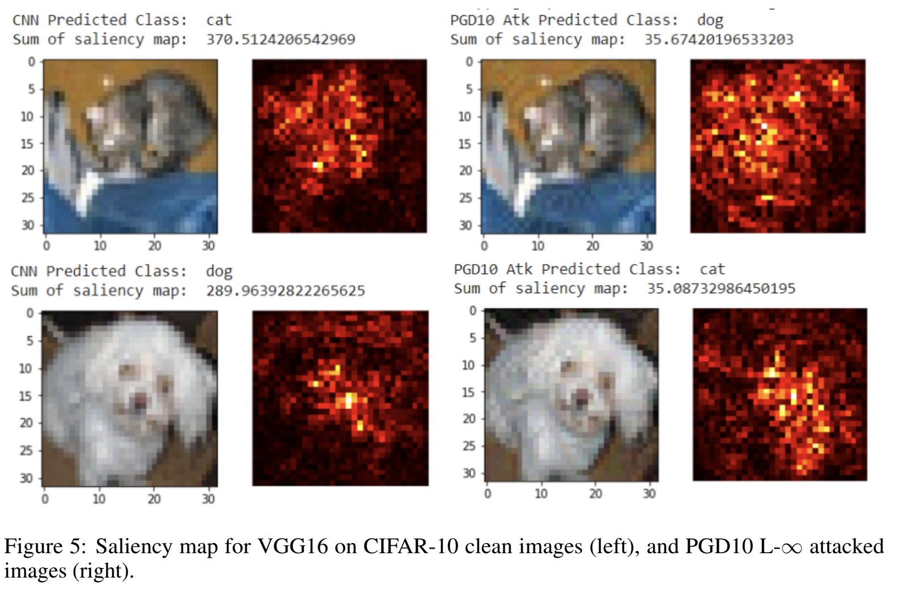
VGG16
PGD-10
L-Infty
Introduction - Background - Experimental Results - Conclusion and Future Work
Notes:
The first example is VGG16, attacked by PGD-10 under the L-Infinity Norm
The clean examples are on the left and adversarial examples on the right
The saliency maps for the clean and adversarial examples are pretty similar but it is clear that many activations have changed.

Slide 33
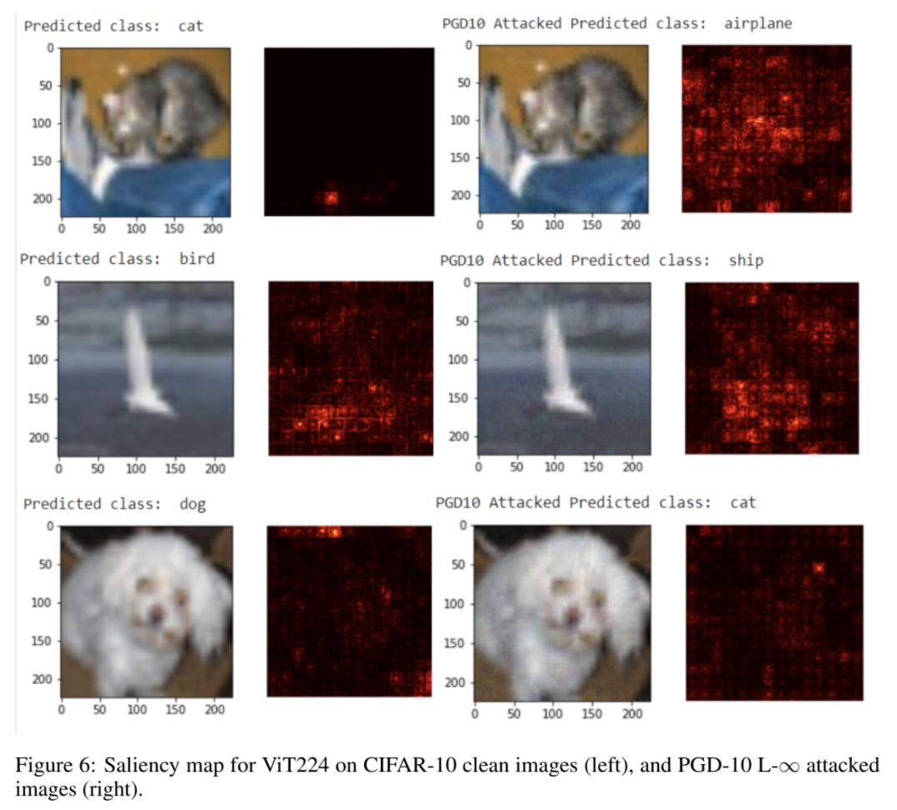
VIT224
PGD-10
L-Infty
Introduction - Background - Experimental Results - Conclusion and Future Work
Notes:
Now for VIT. This is the same attack as the previous slide, with clean images on the left and attacked images on the right.
The first thing to notice is the grid like checkerboard pattern in the saliency maps.
This is due to the image being cut up into 16x16 patches and each patch being processed independently.
[Show Next Slide]
Another weird thing is how for the clean cat image only a single patch lights up. It is unclear to us why this happens.
At first we thought it might have been a bug but it seems to be a recurring pattern in some images.
8/255

Slide 34
Background
--Vision Transformer(ViT)
Introduction - Background - Experimental Results - Conclusion and Future Work
Notes:
Here is main framework for ViT model.
Basically, the whole image has been divided into small patches and then put into the transformer encoder to do classification.

Slide 35
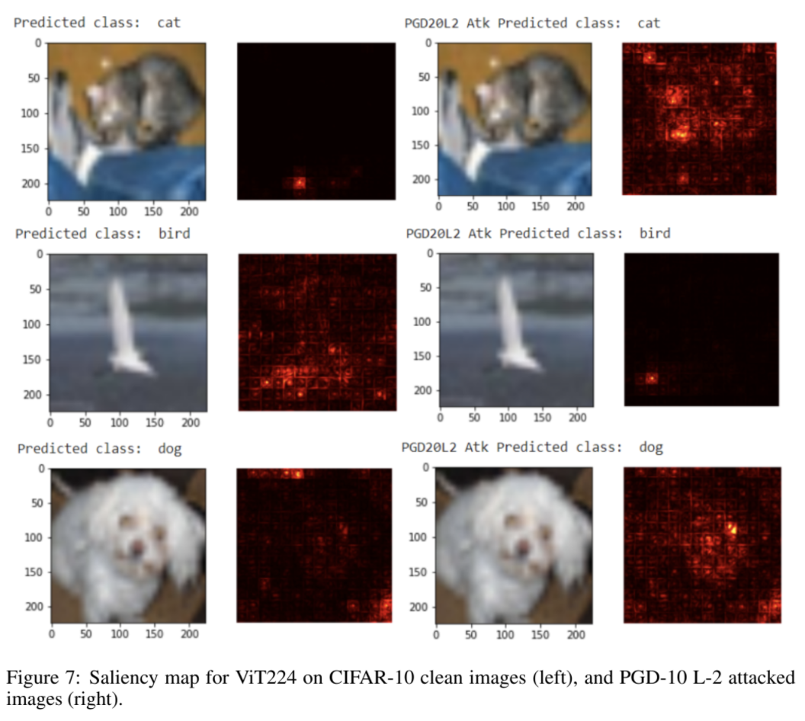
VIT224
PGD-10
L-2
Introduction - Background - Experimental Results - Conclusion and Future Work
Notes:
After the l inf attack we saw ViT attacked by PGD-10 under the L-2 Norm.
[Bird Adversarial] The single patch lighting up again shows up here. Interestingly it is in the adversarially attacked image and not the original bird image.
Even though the activation patterns changed drastically it was surprising to us how the image classification did not change.
In order to furrther investigate this we tested higher resolution images and made attention maps.
8/255

Slide 36
ImageNet Examples
Introduction - Background - Experimental Results - Conclusion and Future Work

Slide 37
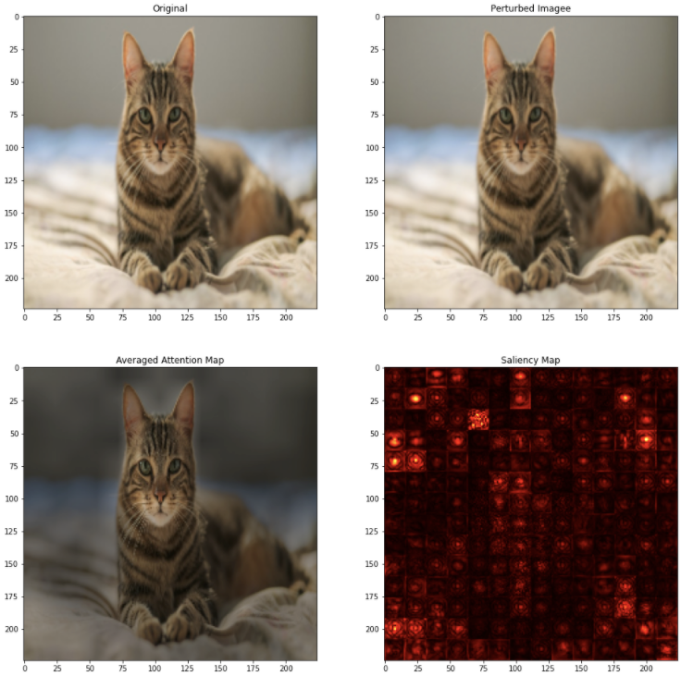
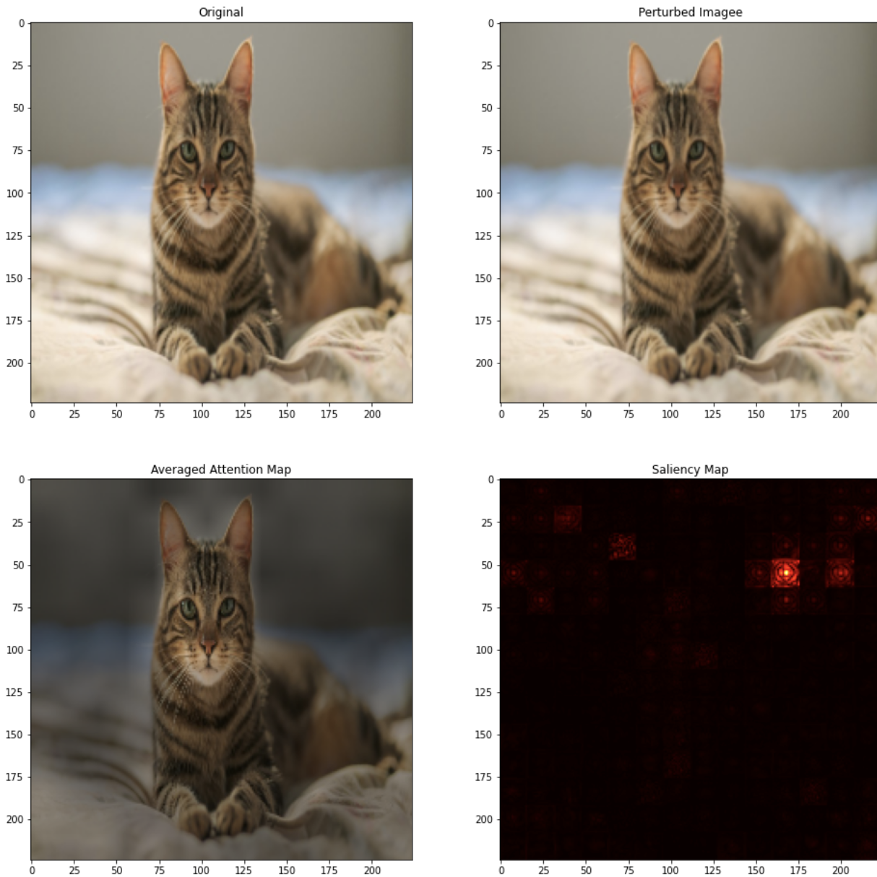
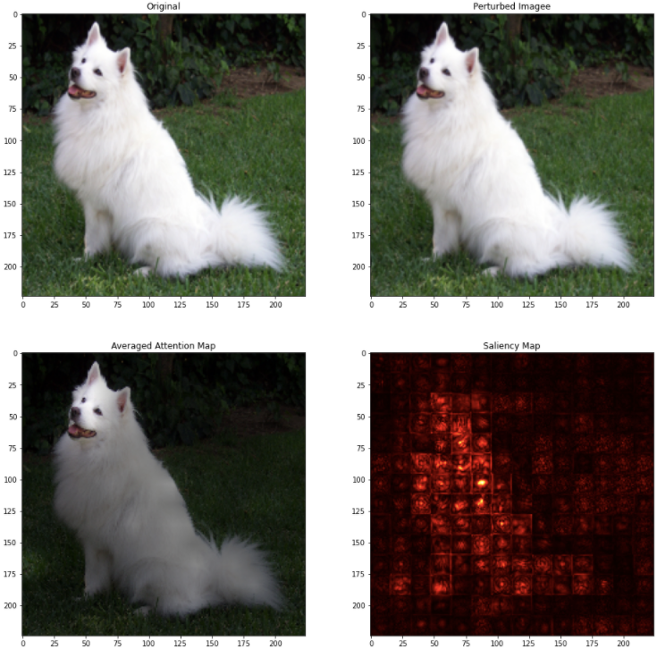
Original Images
Introduction - Background - Experimental Results - Conclusion and Future Work
tabby_cat
samoyed
Notes:
Original Iages
Saliency looks at the entire dog
Attention Map specifically looks at the dogs face
Not sure what happened to the cat saliency map. But this pattern also appeared in the CIFAR examples
Attention Map looks at the cat body
There is ZERO perturbation for the original images

Slide 38
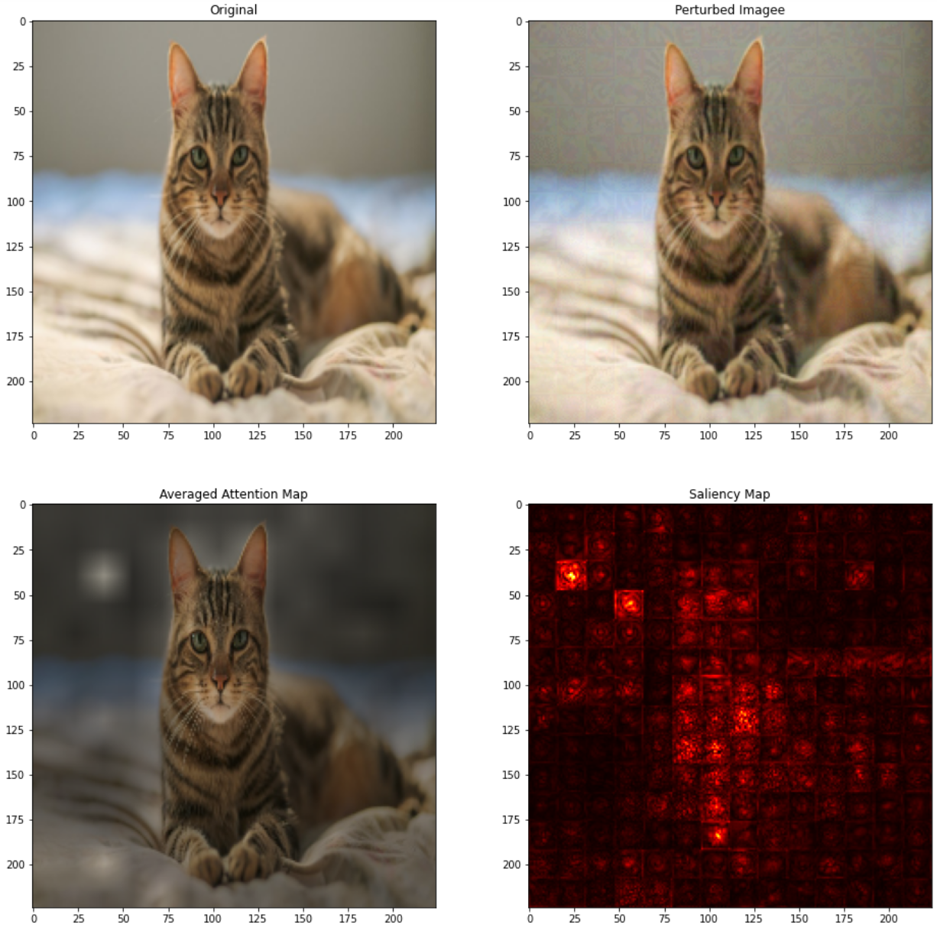
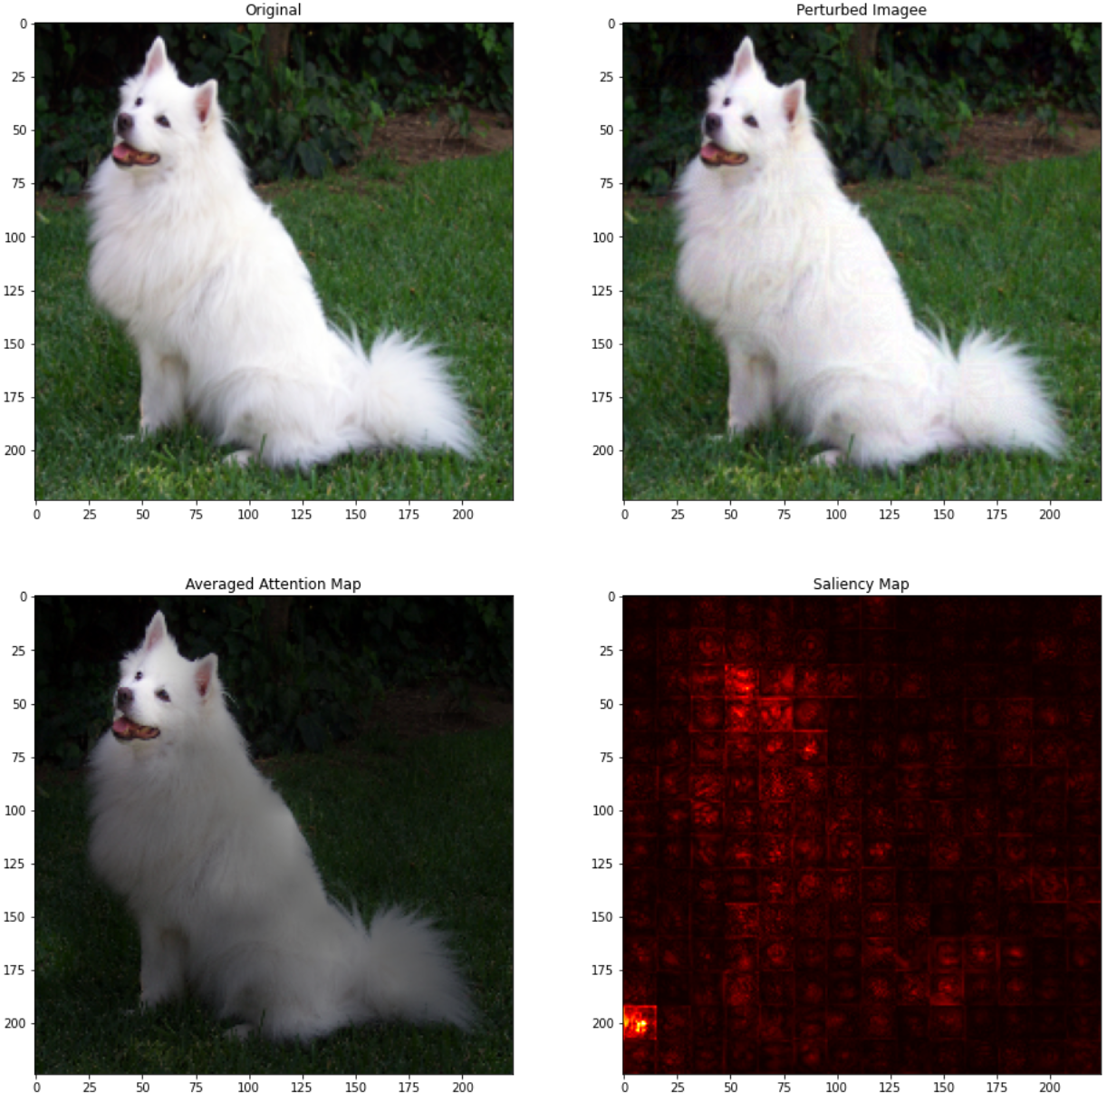
Untargeted, PGD-20 Attack, L-Infty 8 / 255
Introduction - Background - Experimental Results - Conclusion and Future Work
tabby_cat -> egyptian_cat (success)
samoyed -> chihuahua (success)
Notes:
Both Attacks succeed, cat goes from tabby cat -> Egyption Cat and Dog Samoyed - > Chiuaua
The dog saliency is more focused on the face and one corner, attention still mostly focused on facee.
The cat's attention map is cleearly distorted, with a patch on the top left lighting up.

Slide 39
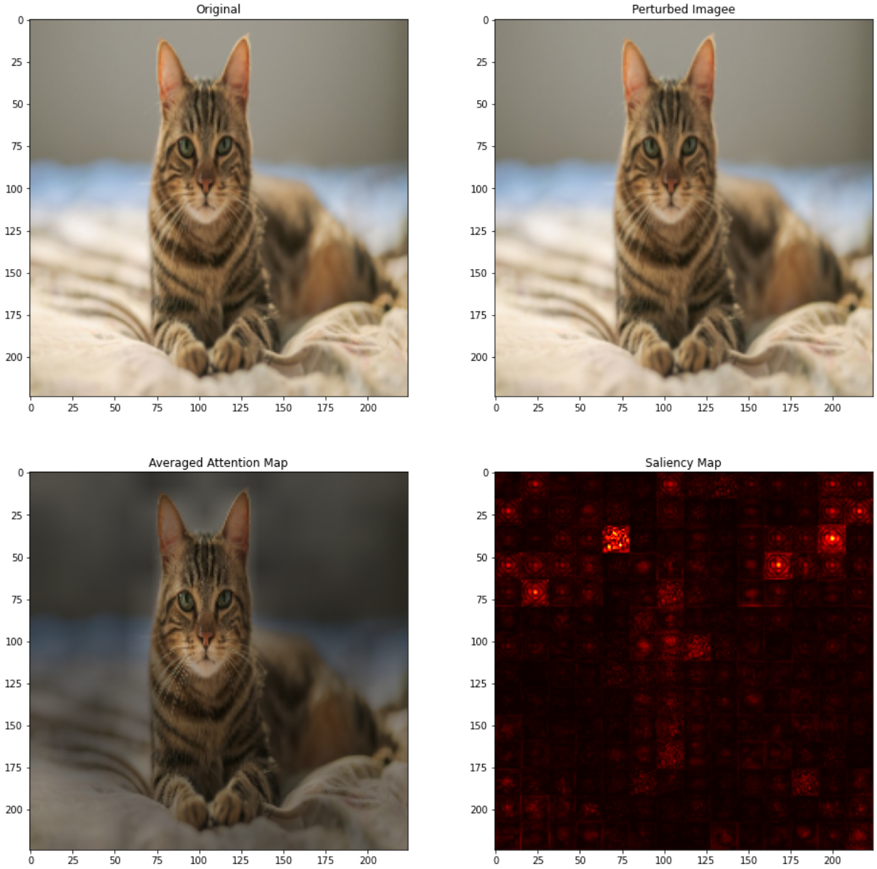
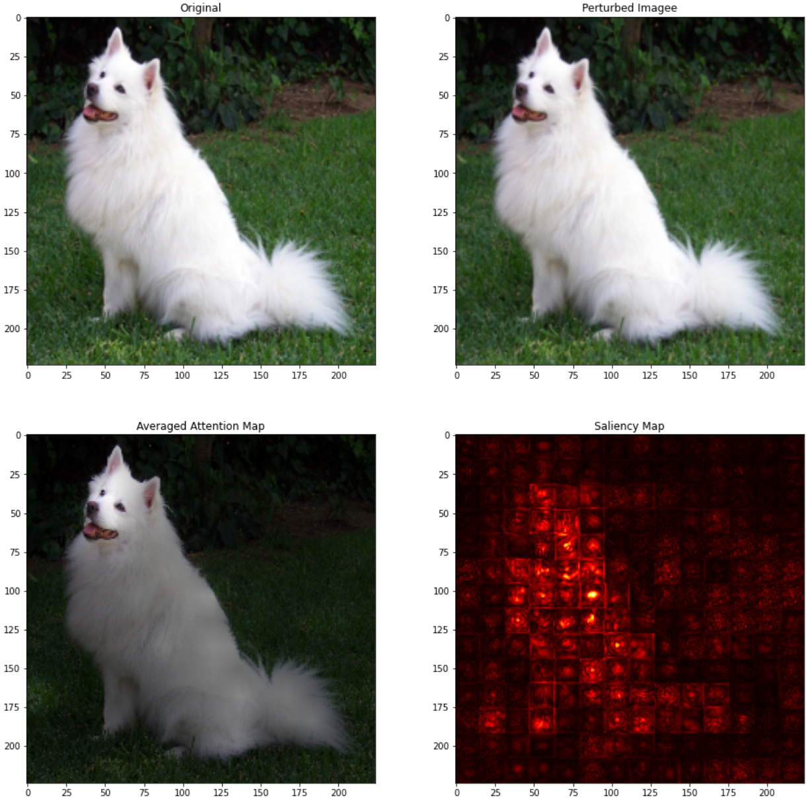
Untargeted, PGD-20 Attack, L-2, 8 / 255
Introduction - Background - Experimental Results - Conclusion and Future Work
tabby_cat -> any_label (failed)
samoyed -> any_label (failed)
Notes:
Untargeted L2 8 / 255, Pgd 20
Both Fail
Dog's saliency and attention barely change [Next prev swap]
Even though some pixel activations for the cat change, the attention map is still focused on the cat iself.

Slide 40
Original Images
Introduction - Background - Experimental Results - Conclusion and Future Work
tabby_cat
samoyed

Slide 41
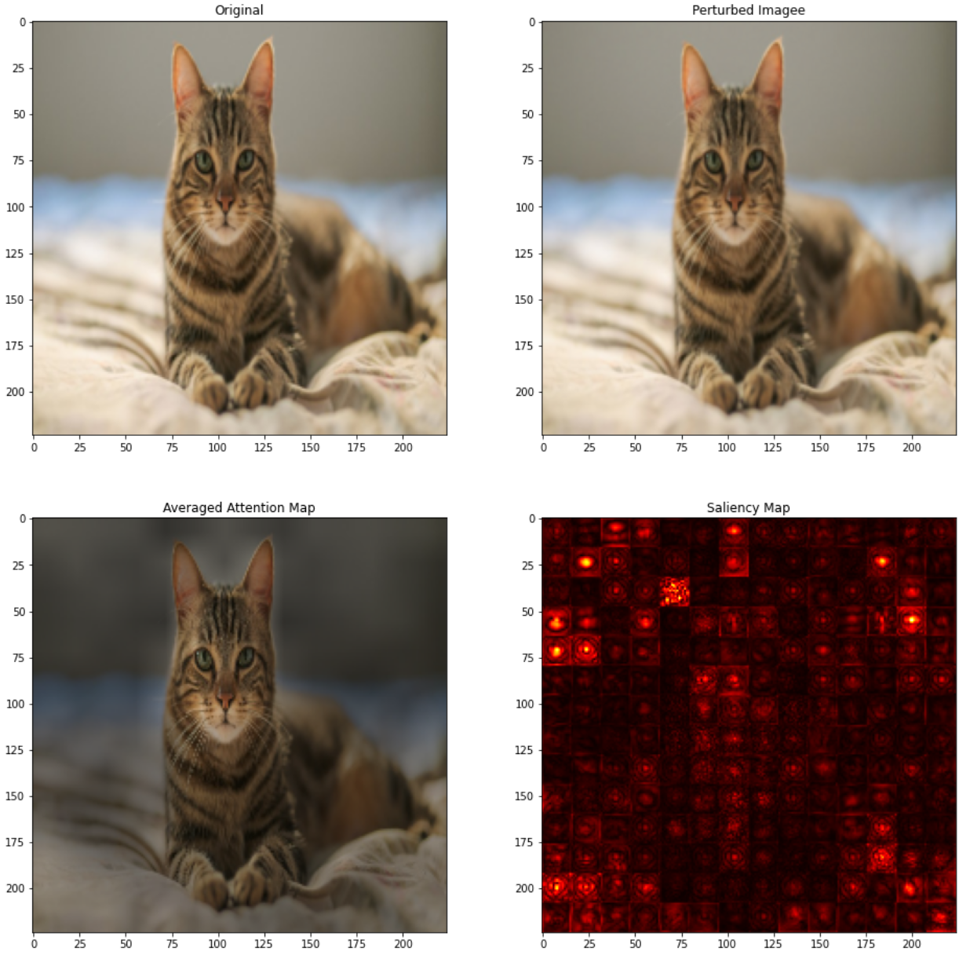
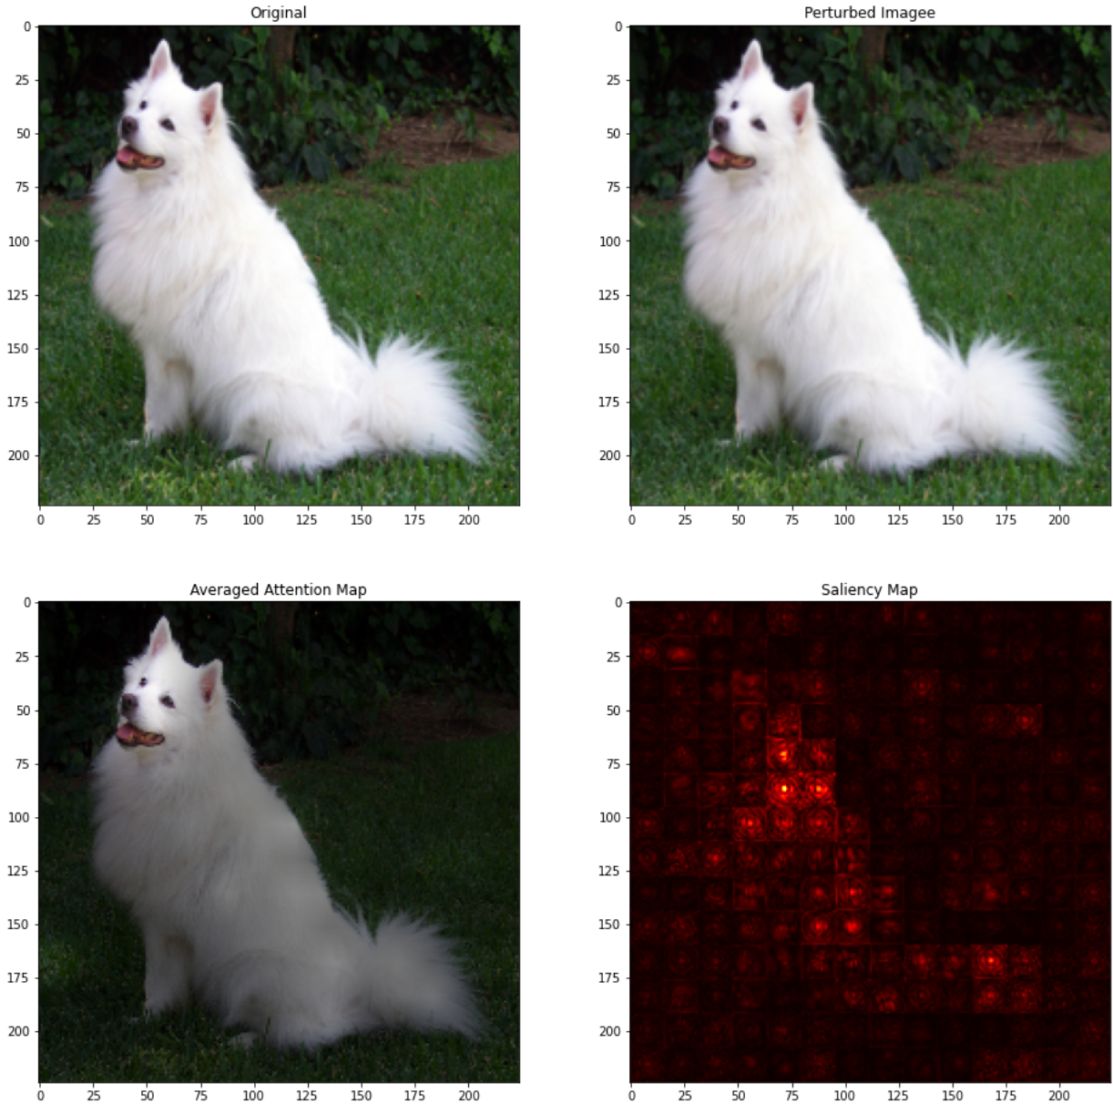
Untargeted, PGD-20 Attack, L-2, 50 / 255
Introduction - Background - Experimental Results - Conclusion and Future Work
tabby_cat -> any_label (failed)
samoyed -> any_label (success)
Notes:
Untargeted L2 50 / 255, Pgd 20
Cat Fail, Dog Succeed, Dog became pomerranian
Like how we observed for CIFAR-10, even with so many activation changes in the pixels, the model is still robust for the Cat image.
Interestingly the Dog's saliency map becomes dimmer! The image might lie at a label boundary perhaps, since there are many subclasses of dogs in the imagenet dataset

Slide 42
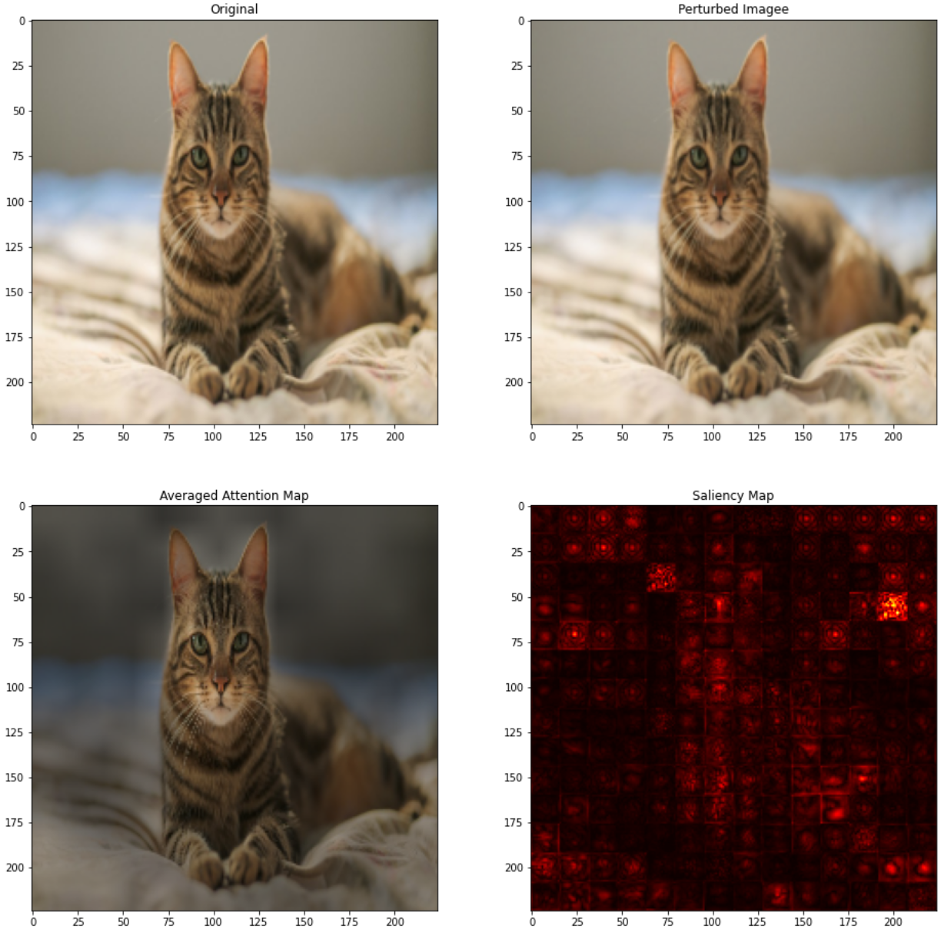
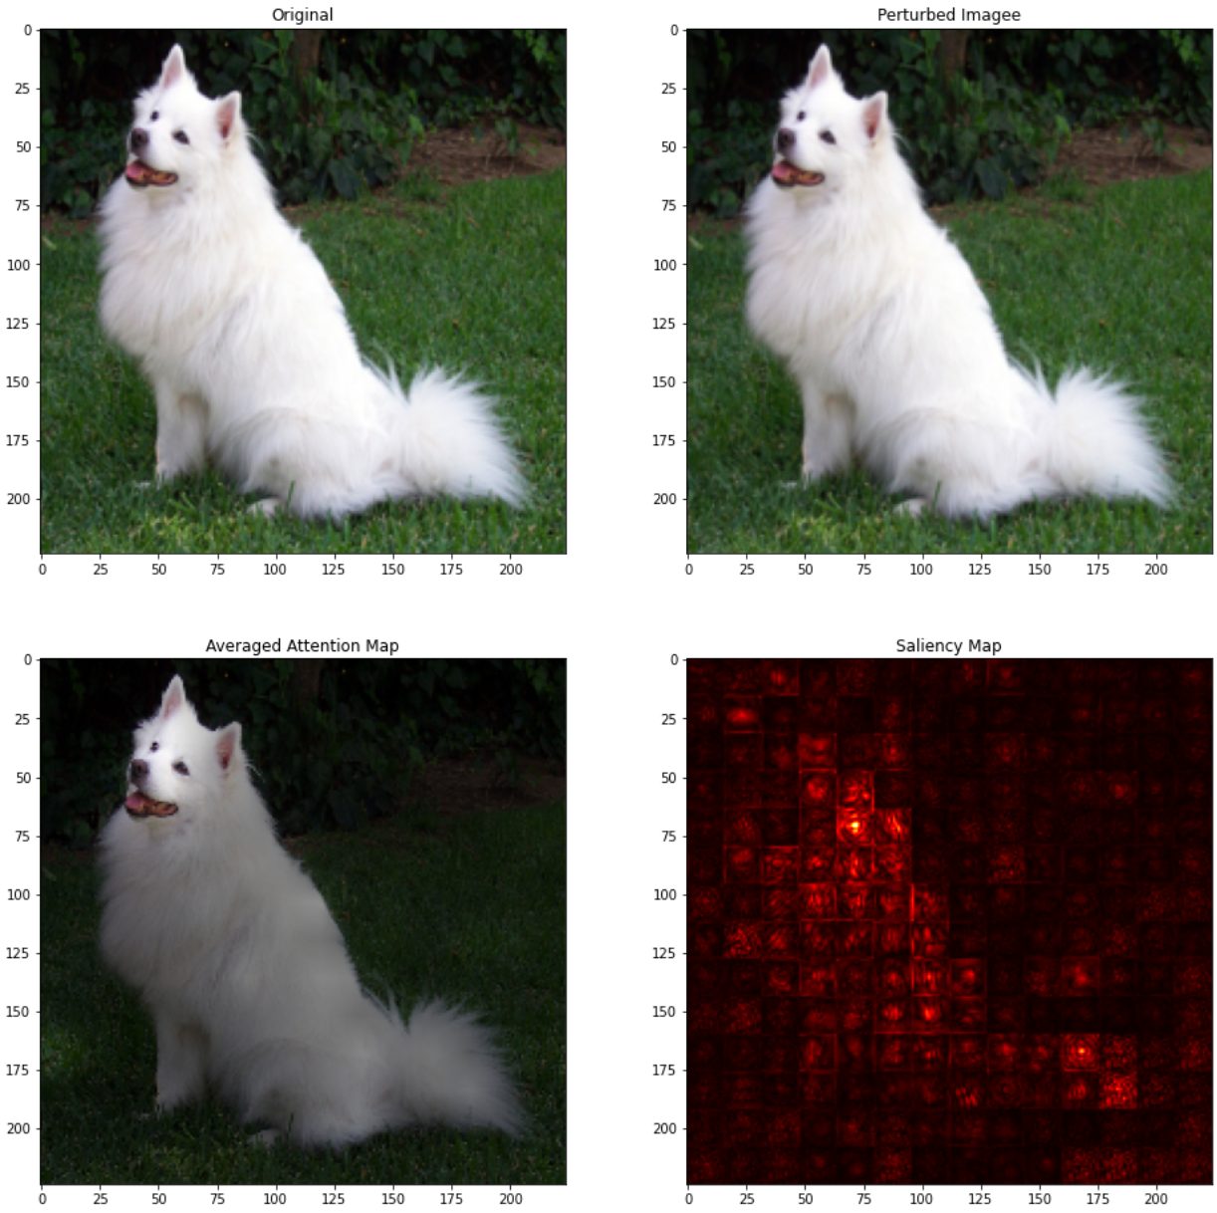
Untargeted, PGD-20 Attack, L-2, 100 / 255
Introduction - Background - Experimental Results - Conclusion and Future Work
tabby_cat -> any_label (success)
samoyed -> any_label (success)
Notes:
With a big enough epsilon Both Succeed, they are still looking at the cat and dog because this is an untargeted attack
both got miss classified as different kinds of cats and dogs
but still requires a much bigger epsilon value than a typical CNN model.

Slide 43
Conclusion

Slide 44
So Are Vision Transformer Models more Adversarially Robust than Convolutional Neural Networks?
Introduction - Background - Experimental Results - Conclusion and Future Work

Slide 45
So Are Vision Transformer Models more Adversarially Robust than Convolutional Neural Networks?
Introduction - Background - Experimental Results - Conclusion and Future Work
Sometimes yes!
L-2 White-Box Attacks
Transfer Attacks

Slide 46
So Are Vision Transformer Models more Adversarially Robust than Convolutional Neural Networks?
Introduction - Background - Experimental Results - Conclusion and Future Work
Sometimes yes!
L-2 White-Box Attacks
Transfer Attacks
Not always
Weak to L-Infinity Attacks

Slide 47
So Are Vision Transformer Models more Adversarially Robust than Convolutional Neural Networks?
Introduction - Background - Experimental Results - Conclusion and Future Work
Sometimes yes!
L-2 White-Box Attacks
Transfer Attacks
Not always
Weak to L-Infinity Attacks
But can still be adversarially trained!

Slide 48
Future Work
Introduction - Background - Experimental Results - Conclusion and Future Work
Possible Ensemble Defence Scheme
Using a combination of CNN and ViT models
Possible Fingerprinting Defence Scheme
Using the checkerboard pattern always visible in ViT models

Slide 49
Thank you

Slide 50
Questions?

Slide 51
Appendix

